Slide 1
Extensions to MapReduce c The evolution
MapReduce and the New Software Stack

Slide 2
TABLE OF CONTENTS
1
2
3
4
Introduction
Workflow Systems
The limits of the MapReduce
A flexible Directed Acyclic Graph structure
Recursive Application
Iterative MapReduce
PageRank and his loop
Multiple passes over data

Slide 3
1
Introduction
Why the need to go further ?

Slide 4
The limit of MapReduce
Limited to Two Phases
High Disk I/O Overhead
No Iterative Processing
Limited Expressiveness for complex task
Slowing down the process
Required manually, which is inefficient and complex

Slide 5
2
Workflow Systems
Directed Acyclic Graph

Slide 6

Structure of a Workflow
A
DFS
D
Output file
B
C
Figure 1 - Directed Acyclic Graph

Slide 7


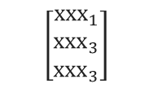




Example : Recommendation System
ID product
Score $α$
$$\left[\begin{matrix}\left(xxx, ααα\right) \\ ⋯ \\ ⋯\end{matrix}\right]$$
A
Analyze Purchase History
Final Recommendation
D
$$\left[\begin{matrix}{xxx}_{1} \\ {xxx}_{3} \\ {xxx}_{3}\end{matrix}\right]$$
Analyze Browsing History
Demographic-Based Analysis
3 recommended items
B
C
$$\left[\begin{matrix}⋯ \\ ⋯ \\ \left(xxx, βββ\right)\end{matrix}\right]$$
$$\left[\begin{matrix}⋯ \\ ⋯ \\ \left(xxx, δδδ\right)\end{matrix}\right]$$
Score $β$
Score $δ$

Slide 8
Comparison Table
Feature | Classic MapReduce | Workflow Systems
Architecture | Two-stage (Map → Reduce) | Multi-stage, DAG-based (any number of steps)
Data Flow | Limited to Map and Reduce | Arbitrary data flow defined by the user
Intermediate Results | Written to disk between jobs | Passed directly between tasks, reducing I/O
Task Parallelism | Parallel map and reduce tasks | Parallelism across arbitrary tasks
Job Orchestration | Manually chain multiple jobs | Single workflow with dependencies between tasks
Fault Tolerance | Re-executes failed Map or Reduce task | Re-executes failed tasks without data duplication
Ease of Use | Simple but rigid | More complex, but allows flexible computation
Optimization | Limited to Map and Reduce phases | Optimized task scheduling and resource usage
Typical Use Cases | Simple large-scale data aggregations | Complex multi-step data processing pipelines

Slide 9
3
Recursive Systems
Iterative Processing until convergence

Slide 10
Issue to avoid
Infinite Loops
Failure Handling
Convergence Check
Maximum Iteration Count
Task Checkpointing : Save intermediate results
Deduplication Tasks : Tasks that explicitly eliminate duplicates before passing data downstream

Slide 11

Google : Page Rank
0,4
A
0,1
0,1
0,05
$$PR\left(P\right)=PR\left(P\right)+\frac{PR\left(i\right)÷2}{L\left(i\right)}$$
B
C
D
0,05
D

Slide 12
Google : Page Rank
0,4
A
0,1
0,125
0,0625
$$PR\left(P\right)=PR\left(P\right)+\frac{PR\left(i\right)÷2}{L\left(i\right)}$$
B
C
D
0,05
E

Slide 13
Google : Page Rank
0,43215
A
0,1
0,125
0,0625
$$PR\left(P\right)=PR\left(P\right)+\frac{PR\left(i\right)÷2}{L\left(i\right)}$$
B
C
D
0,05
E

Slide 14
4
Iterative MapReduce
Resilient Distributed Datasets (RDDs)

Slide 15
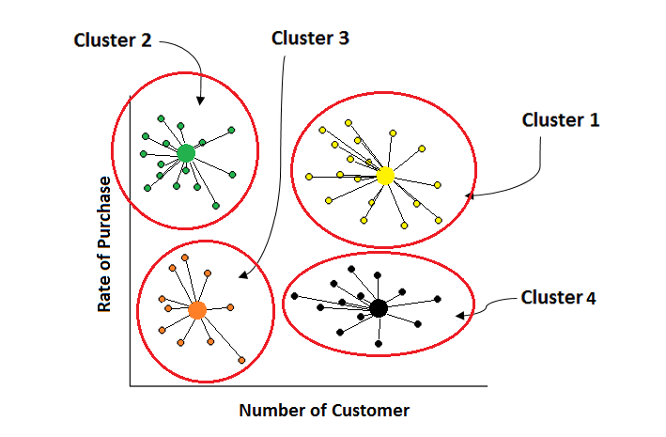
Clustering

Slide 16
Thanks for listening

